Slide 1
Galaxy Quest
A bottom up approach by Vi Conrad
Never give up. Never Surrender.

Slide 2

What is Galaxy Quest?

Slide 3
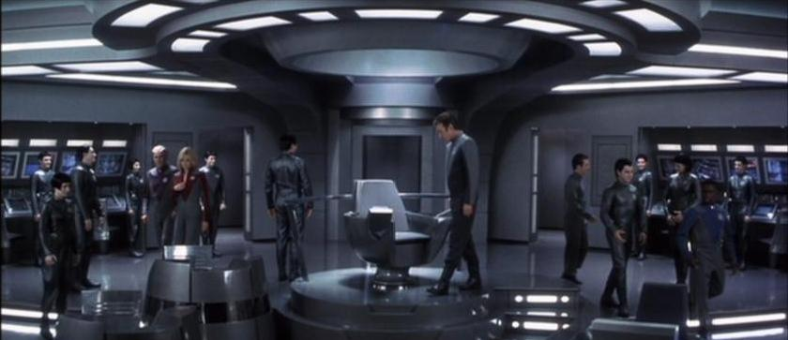
The Command Bridge
Notes:
Captain Chair:
- the classic commander chair
- two large rectangles on each arm
respond to hand movements
- appears to be no output throughout the film as many things are just voice activated.
- to accomplish goal of manipulating screen: not really do much?
- 1:29:53, the activation for the omega 13 is a twist handle
Video to show input and output
Goal of the command bridge: to control the ship

Slide 4
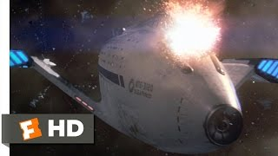
https://youtu.behttps://youtu.be/_zSpueUqvcs/_zSpueUqvcs
Notes:
https://youtu.behttps://youtu.be/_zSpueUqvcs/_zSpueUqvcs

Slide 5
The Command Bridge
Notes:
Captain Chair:
- the classic commander chair
- two large rectangles on each arm
- respond to hand movements
- appears to be no output throughout the film as many things are just voice activated.
- to accomplish goal of manipulating screen: not really do much?
- 1:29:53, the activation for the omega 13 is a twist handle
Giant screen
Tick marks/gauge on both sides of the screen
Input is the video, but it doesn't go into how to manipulate the screen
Smaller info panels on the bottom
Change color as the video call progresses - Level histogram like in photoshop?
The calls just answer, the enemy called and there was no answer button

Slide 6

The Command Bridge
Notes:
Captain Chair:
- the classic commander chair
- two large rectangles on each arm
- respond to hand movements
- appears to be no output throughout the film as many things are just voice activated.
- to accomplish goal of manipulating screen: not really do much?
- 1:29:53, the activation for the omega 13 is a twist handle
Giant screen
Tick marks/gauge on both sides of the screen
Input is the video, but it doesn't go into how to manipulate the screen
Smaller info panels on the bottom
Change color as the video call progresses - Level histogram like in photoshop?
The calls just answer, the enemy called and there was no answer button

Slide 7
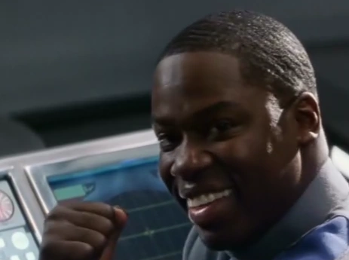
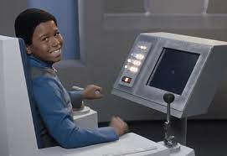
Lieutenant / Navigator controls
Notes:
lieutenant/navigator controls
2 screens side by side
1 with presumably speed and navigation, but Some of it is used to fire projectiles
the second larger screen shows for surrounding objects
A joystick with a cog-like controller on left side
Like a motorcycle handle
A joystick like ones on Galaga games or old-school arcade machine on the other side
Has little sections for 4 fingers on back
Similar to car gearstick
Screen shown at 39:27
Presses turbo button which is in the same place as the start engine button
Its a flat button on a screen, might be better if it was haptic
Cannot hold down, for quick boosts
Can be held down, not auto deactivated
No explanation or timer/overload/gauge to show that turbo is running out and not to be used long term
Ship keeps moving even though let go of controls
“Set a course for home” at 1:27:27
Navigator says it’s just point and click, but its a mouse and a touchpad?
1:37:03
Shouldnt work!

Slide 8

Lieutenant / Navigator controls
Notes:
lieutenant/navigator controls
2 screens side by side
1 with presumably speed and navigation, but Some of it is used to fire projectiles
the second larger screen shows for surrounding objects
A joystick with a cog-like controller on left side
Like a motorcycle handle
A joystick like ones on Galaga games or old-school arcade machine on the other side
Has little sections for 4 fingers on back
Similar to car gearstick
Screen shown at 39:27
Presses turbo button which is in the same place as the start engine button
Its a flat button on a screen, might be better if it was haptic
Cannot hold down, for quick boosts
Can be held down, not auto deactivated
No explanation or timer/overload/gauge to show that turbo is running out and not to be used long term
Ship keeps moving even though let go of controls
“Set a course for home” at 1:27:27
Navigator says it’s just point and click, but its a mouse and a touchpad?
1:37:03

Slide 9
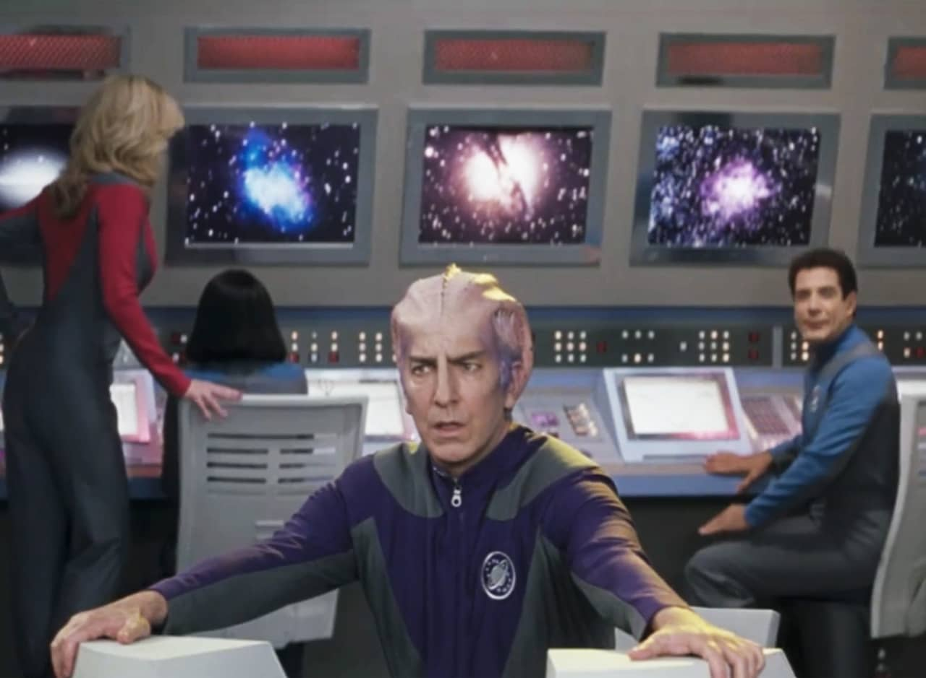
Back Screens
Notes:
Back walls of control room
Lots of buttons that don't look named
Screens seem to have security footage of different areas of the ship
Also looks like a motherboard
Went fuzzy when the ship was hit
Like old time box TVs. when they explode, they’re almost empty on the inside
38:04 - close u of the back wall controls
The buttons on the back frame and pad are just the same set of buttons/levers but flipped
38:10 shows closeup of screen - looks nautical and coordinates, but are there coordinates in space?

Slide 10
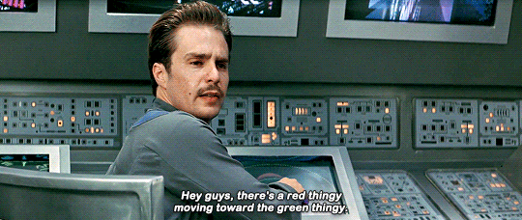
Back Screens
Notes:
Back walls of control room
Lots of buttons that don't look named
Screens seem to have security footage of different areas of the ship
Also looks like a motherboard
Went fuzzy when the ship was hit
Like old time box TVs. when they explode, they’re almost empty on the inside
38:04 - close u of the back wall controls
The buttons on the back frame and pad are just the same set of buttons/levers but flipped
38:10 shows closeup of screen - looks nautical and coordinates, but are there coordinates in space?

Slide 11
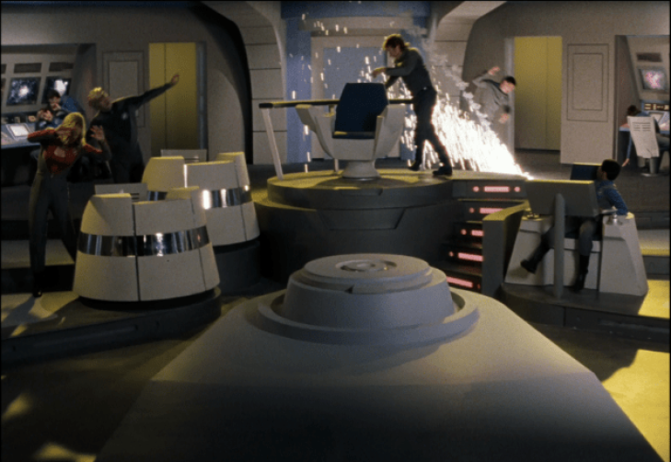
Explosions!
Notes:
When hit, steam comes from everywhere. Maybe everything is liquid cooled?

Slide 12
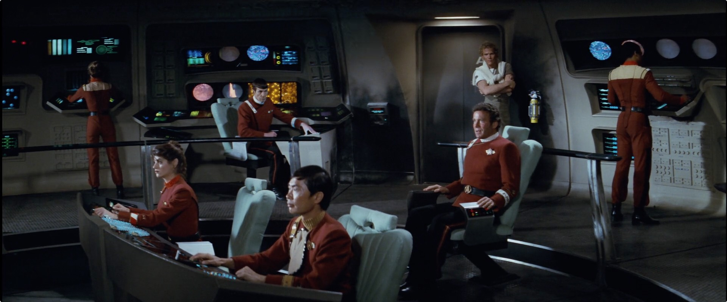
Star Trek II: The Wrath of Khan (1982)
Notes:
Goal of controlling the ship
Galaxy quest based off star trek
What translated from earlier to galaxy quest?
Captains chair: doesn’t really do much but always has the emergency secret weapon

Slide 13
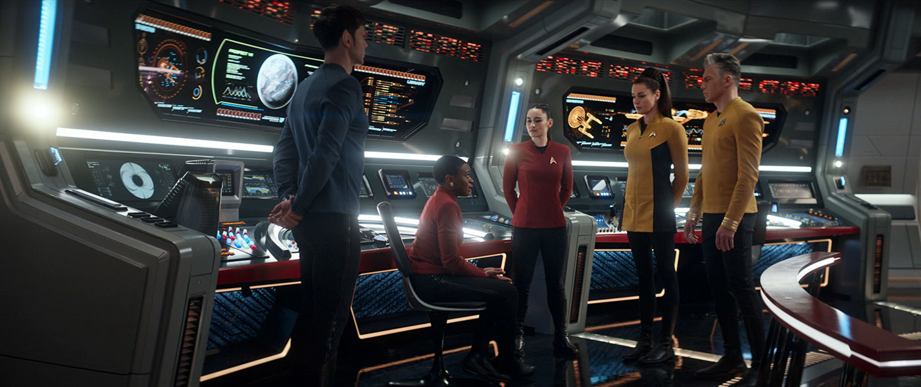
Star Trek: Strange New Worlds (2022)
Notes:
Goal of controlling the ship
Galaxy quest based off star trek
What translated from earlier and galaxy quest?

Slide 14
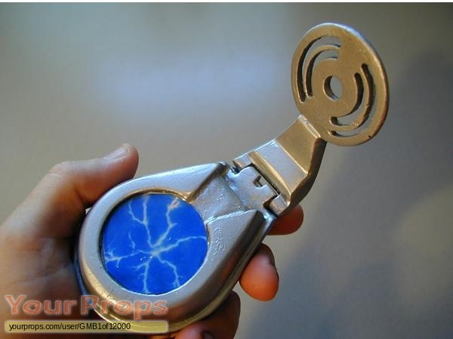
Interstellar Vox
Notes:
Interstellar vox
Flips, kinda like a flip phone but is more similar to a circular makeup palette
No buttons, electric static on top part, bottom part appears to be circular, potentially mic?
Walkie talkie like?
Crew talks into large round part

Slide 15

https://youtu.be/nW-NiGp1gys
Notes:
Digital conveyor control room
At 55:46, the right side of the control room is shown with 2 sets of 6 screens shoen side by side
One podium in the center, has 2 motorcycle like controls and a screen in the middle. On both sides of the screen ar lots of buttons with no labels
Screen shows target and can lock onto target
“Translator circuit” - not shown but appears to be a long bar on panel
Buttons on the edges of the circular podium but they arent labeled or used
https://youtu.be/nW-NiGp1gys

Slide 16
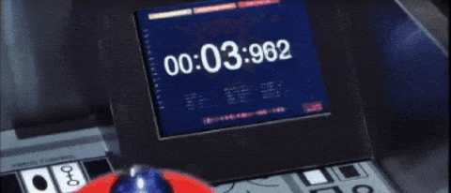
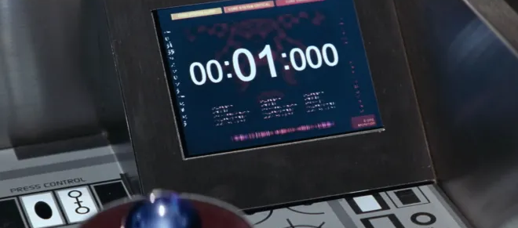
Shutdown Panel
Notes:
To shut down core
Panel, everything that is not the red button is the same pattern as the control deck.
Small screen that shows the countdown
There are some small labels like “press control” “sync” “output” ”normal” “aux” “f” “s” “relay” “mkl” “tki” Line” “heaters” “oms eng” “gfc crt” “nose” “air data” “general control” “on”(without label. Just on)
Drawn on looks like ship steering wheel and other symbols?
1:22:36 - shown clearly.

Slide 17

A Quick Note on Apologetics
All the gears were designed with the crew and tv show in mind, but it doesn't necessarily translate well, as seen by the take off scene at 32:29
At 36:22, the aliens are unable to operate the tech under stressful circumstances
Blowing up sequence - always stops at 1 on the show, did it ever have the blow up function?

Slide 18
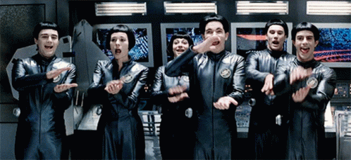
Thanks!
Do you have any questions?
Resources:
https://sfy.ru/?script=galaxy_quest
Parisot, D. (1999). Galaxy Quest. DreamWorks Distribution
https://treknews.net/2022/06/09/review-star-trek-strange-new-worlds-106-lift-us-where-suffering-cannot-reach/
Please keep this slide for attribution

